Slide 1
Unit test

Slide 2
dfdfdf
dfdf

Slide 3
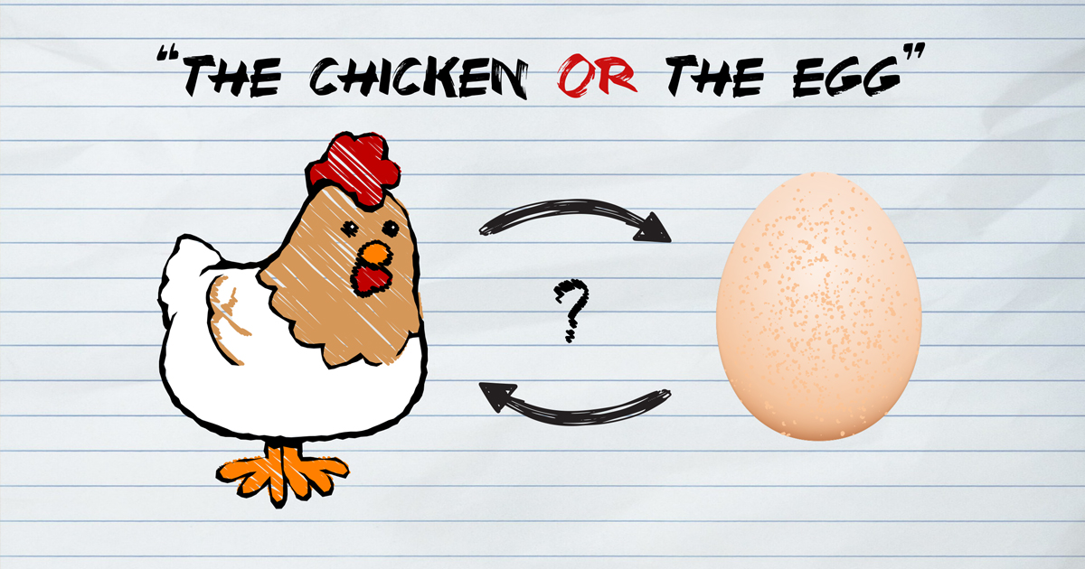
Chicken-egg problem in software development

Slide 4
Test first or code first?
It’s clean code that matters
TDD provides opportunity to create a masterpiece that proactively unbreakable and reduce time to market.

Slide 5
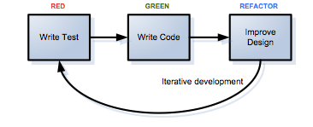
TDD is easier than I thought

